Slide 1
Diabetes, Hypertension, and Stroke Analysis

Slide 2
Table of Contents
01.
Context
Project Goal
02.
Dataset
Description of data and exploratory analysis
03.
Analysis
How different predictive models were used
04.
Summary
Findings and recommendations

Slide 3
Project Objectives
Group
The similarities between diabetes, hypertension, and stroke
Predict
The probability of developing diabetes, hypertension, stroke
Recommend
Ways that an individual can reduce his/her risks of developing either health condition

Slide 4
Quick Facts
Stroke is the 5th leading cause of death in the United States
Every 40 seconds, someone in the United States has a stroke
Diabetes is the 7th leading cause of death in the United States
More than 37 million people in the United States have diabetes, and 1 in 5 of them don't know they have it
Nearly half of adults in the United States have hypertension
Hypertension can put you at risk of heart disease (1st leading cause of death in United States) and stroke

Slide 5
Dataset Description
Demographic Risk Factors
Age
Sex
Behavioral Risk Factors
Cholesteral Check
Smoker
Physical Activity
Consumes Fruits
Consumes Vegetables
Heavy Alcohol Use
70,692 responses from the CDC's Behavioral Risk Factor Surveillance System survey in 2015
Medical History Risk Factors
BMI
High Cholesteral
Heart Disease or Heart Attack
General Health Scale
# of Days of Poor Mental Health in Past 30 Days
Physical Illness or Injury in Past 30 Days
Difficulty Walking or Climbing Stairs
Diabetes
Hypertension
Stroke

Slide 6
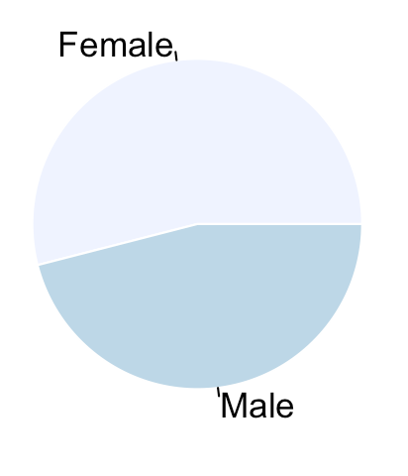
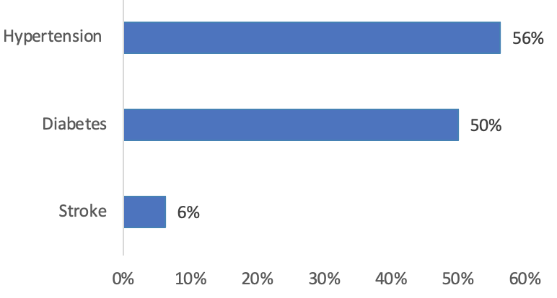
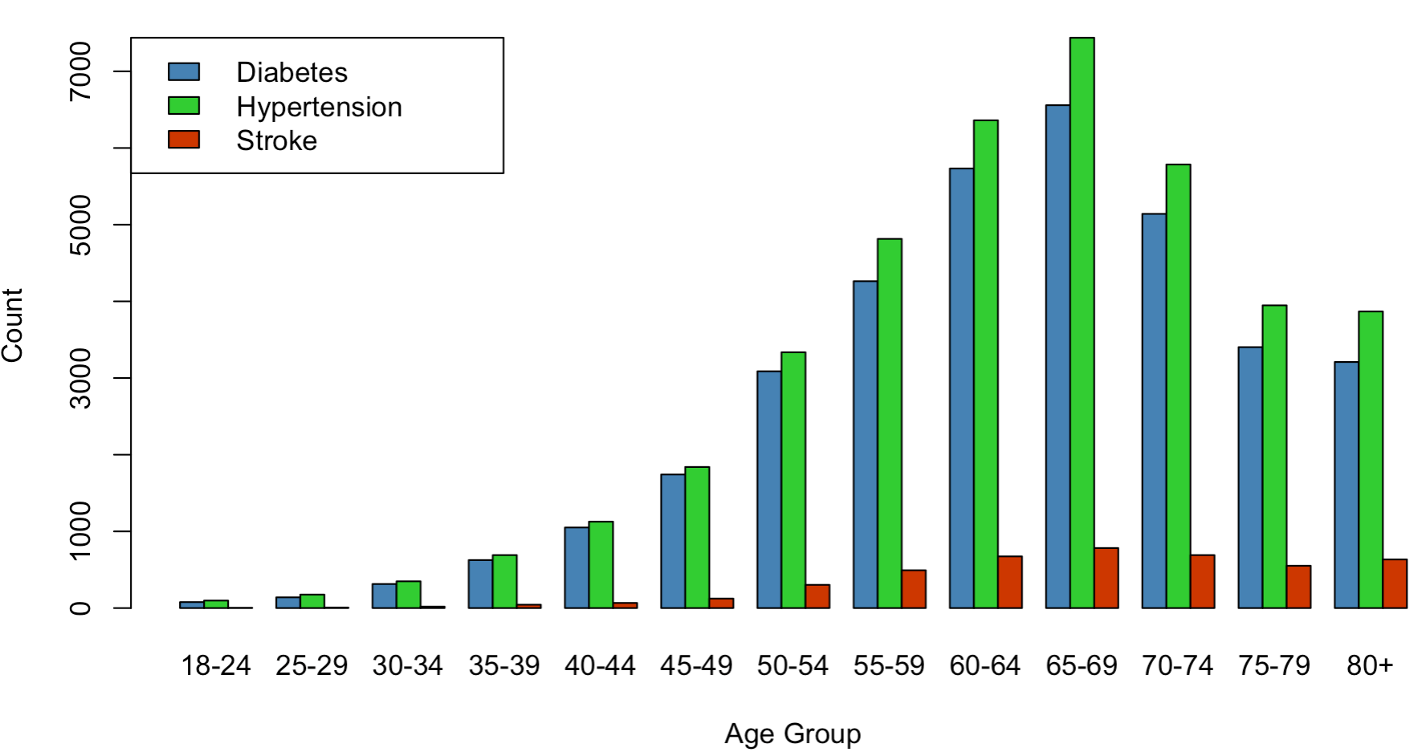
Exploratory Analysis
54%
Over half of our population
lives with hypertension
Slightly more female respondents
46%
Hypertension and Diabetes are more prominent between the ages of 60 - 74

Slide 7
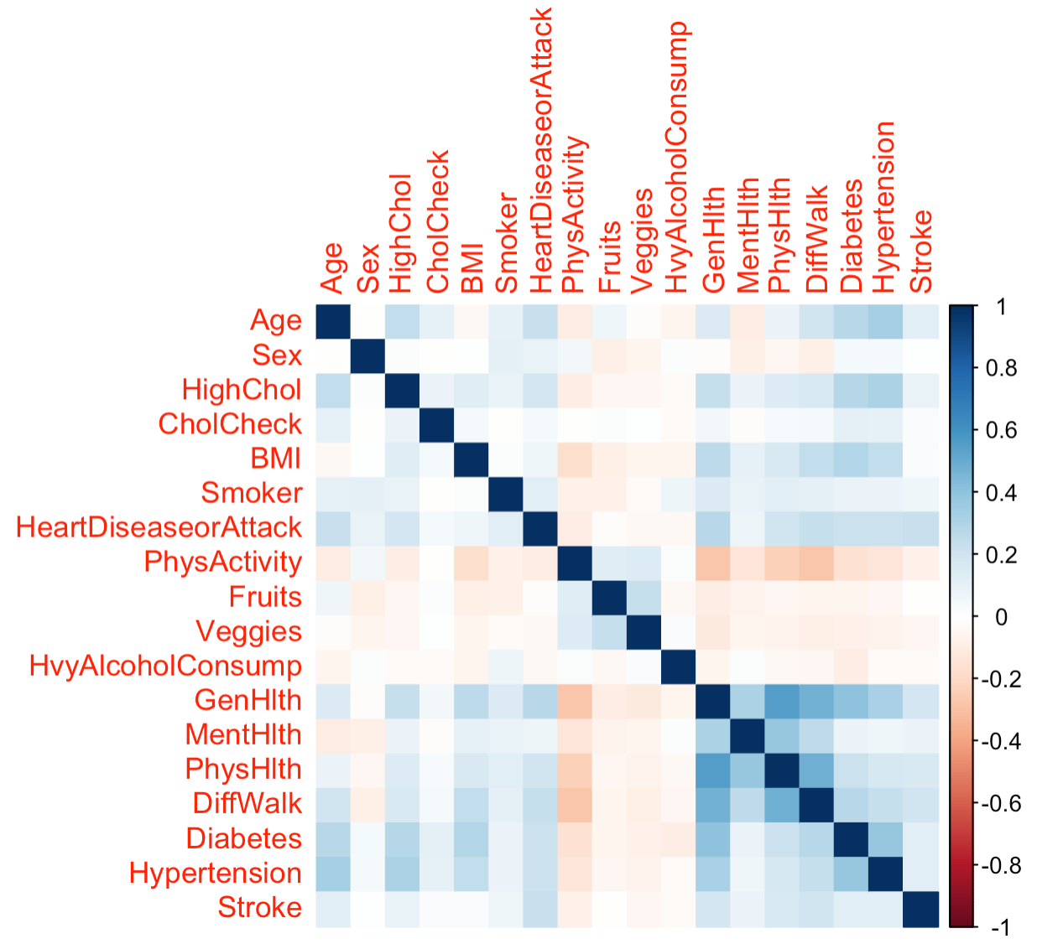
Exploratory Analysis (cont.)
General health is primairly correlated with physical health, but also with difficult to walk, diabetes, and hypertension

Slide 8

Logit Regression

Slide 9


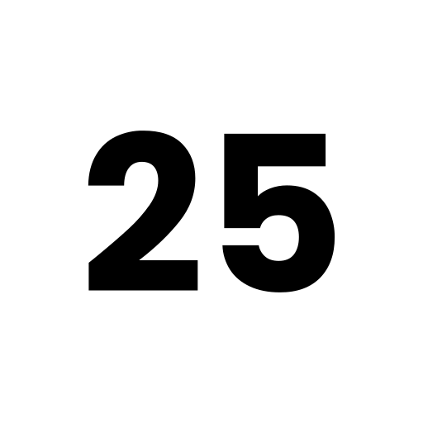

SPLITTING THE DATA
TRAINING DATA
TESTING DATA

Slide 10
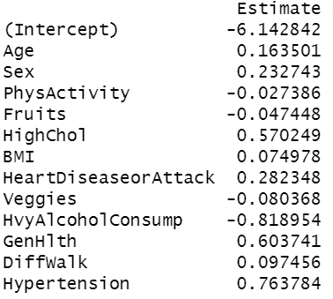
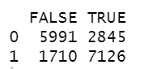
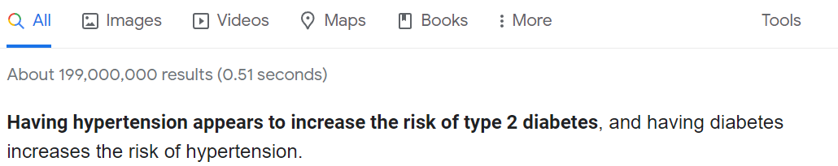
Target Variable: Diabetes
Used the following independent variables:
Confusion matrix (Test Data)
Model Accuracy: 74.24%
Baseline Accuracy: 50%

Slide 11
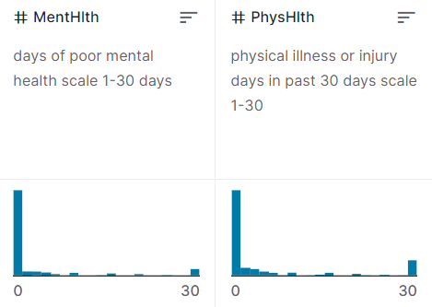
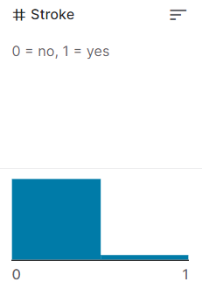
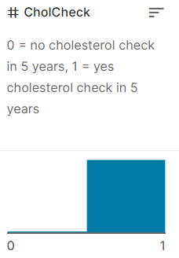
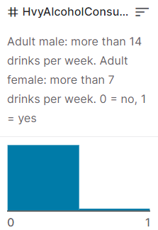
Variables Ignored:
Why ?
Including this gave a coefficient value of -0.816. Heavily skewed data.
Variables have negligible coefficient and data is mainly skewed to 0-5, 30
Data is heavily skewed
Data is heavily skewed

Slide 12
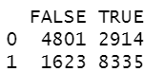
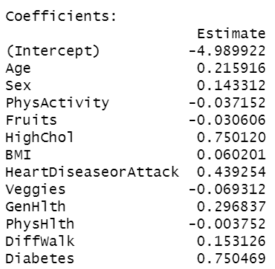
Target Variable: Hypertension
Used the following independent variables:
Confusion matrix (Test Data)
Model Accuracy: 74.32%
Baseline Accuracy: 56.34%

Slide 13
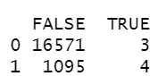
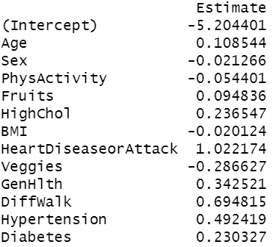
Target Variable: Stroke
Used the following independent variables:
Confusion matrix (Test Data)
Model Accuracy: 93.78%
Baseline Accuracy: 93%

Slide 14
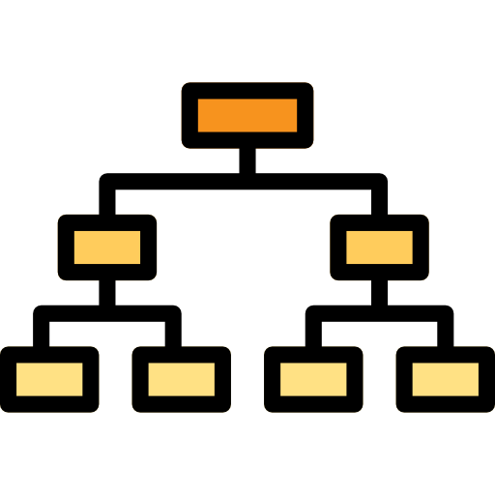
Classification Trees

Slide 15
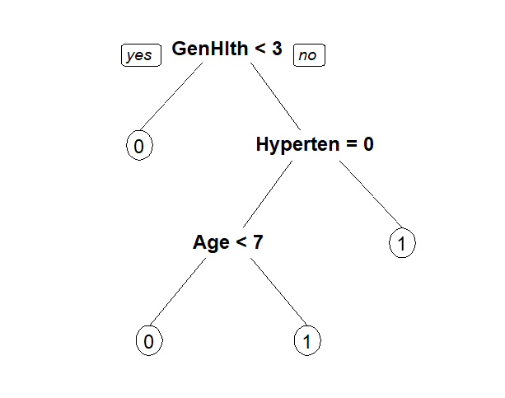
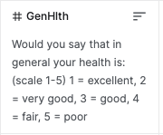
Diabetes
Model Accuracy: 70.73%
Baseline Accuracy: 50%

Slide 16
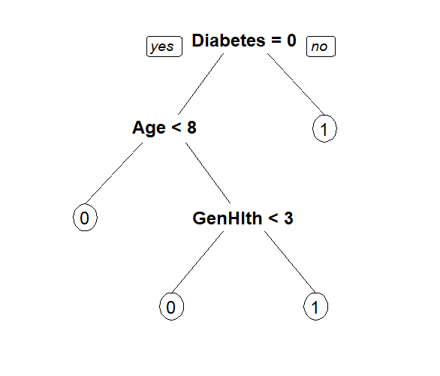
Hypertension
Model Accuracy: 71.97%
Baseline Accuracy: 56.34%

Slide 17

Kmeans Clustering & Other Exploration

Slide 18


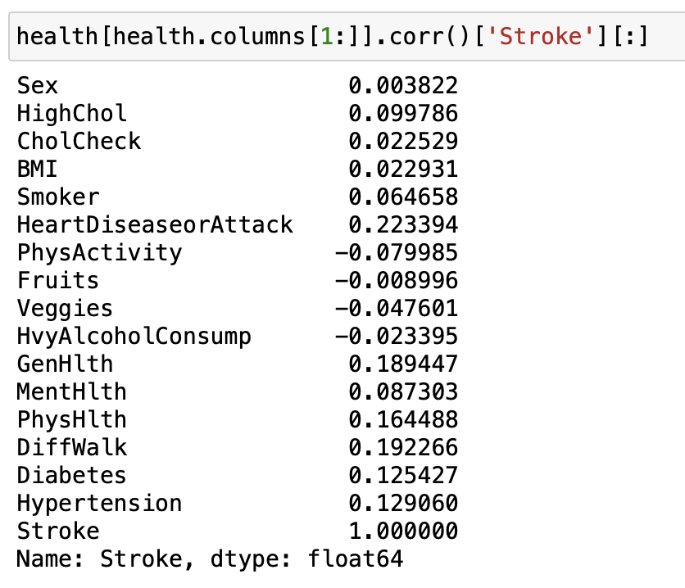
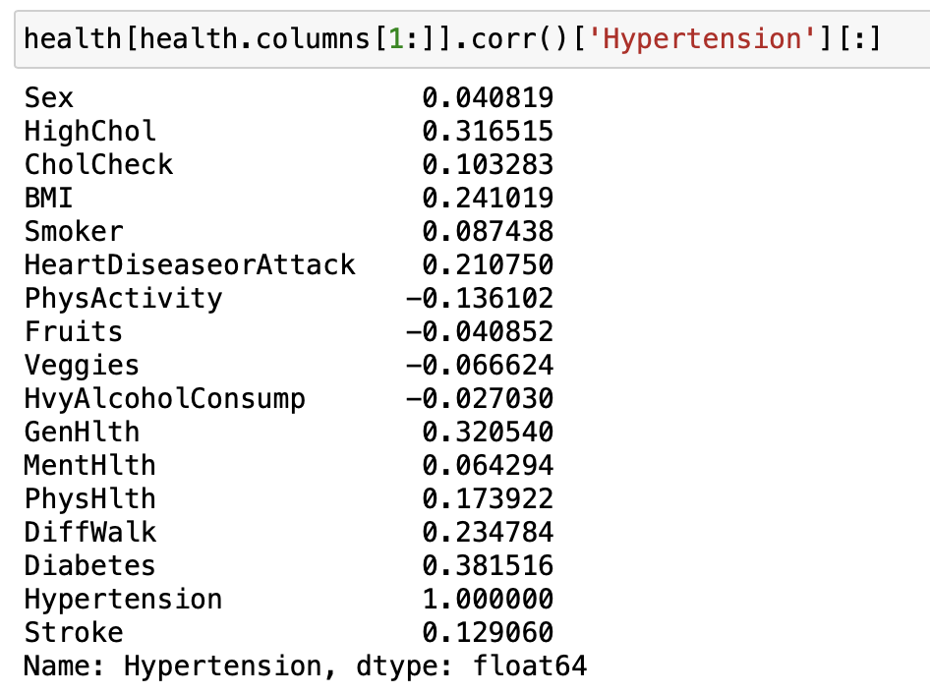
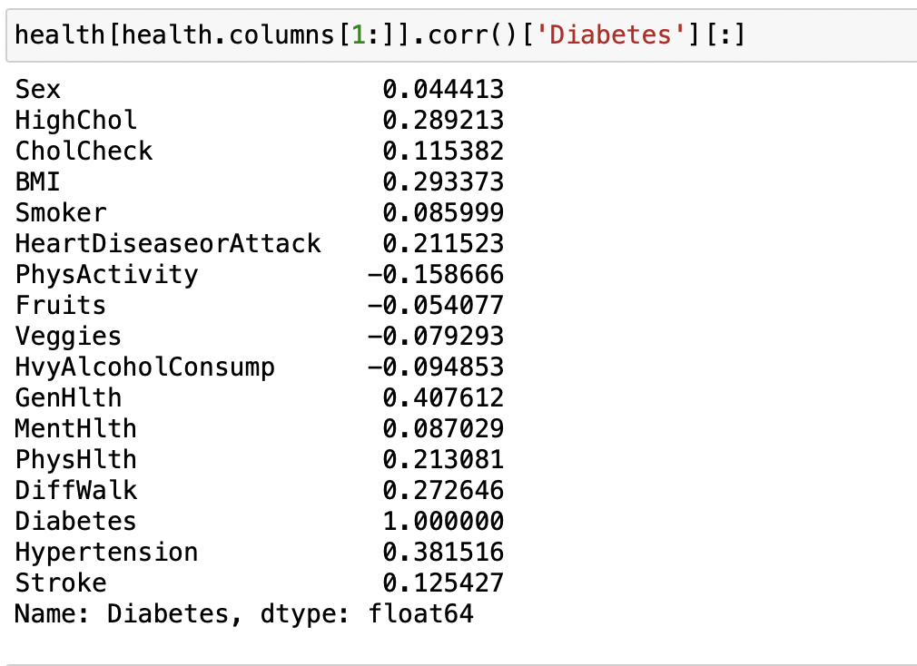
Understand Correlation

Slide 19
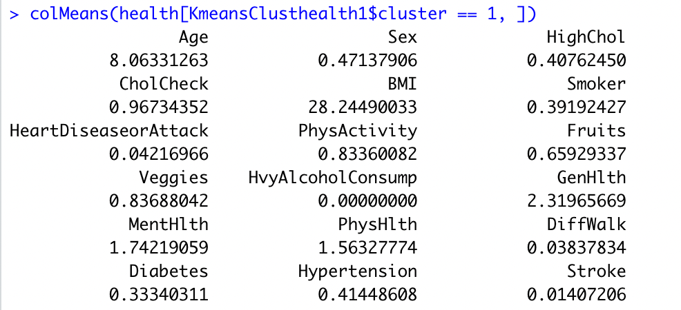
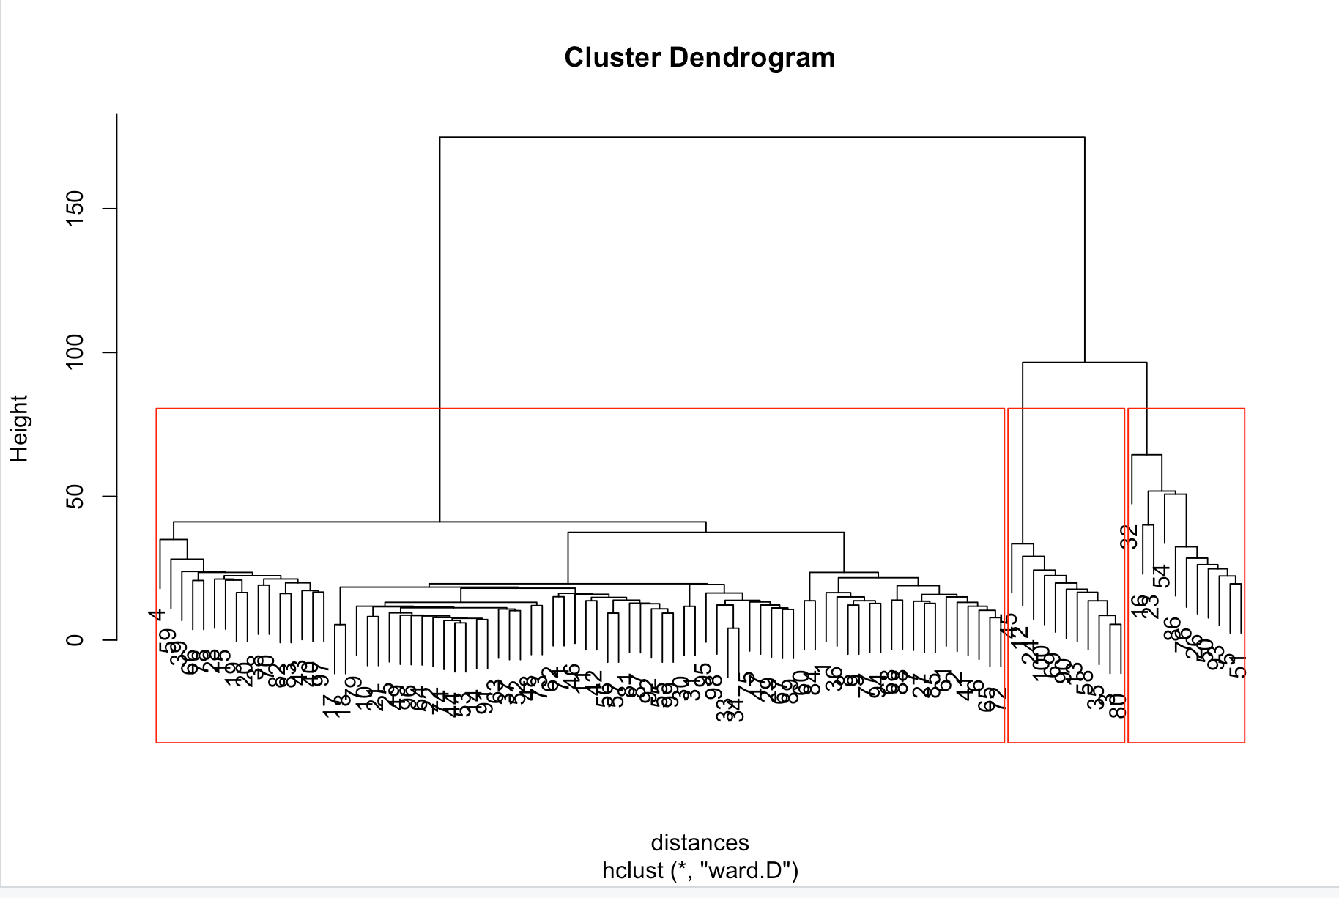
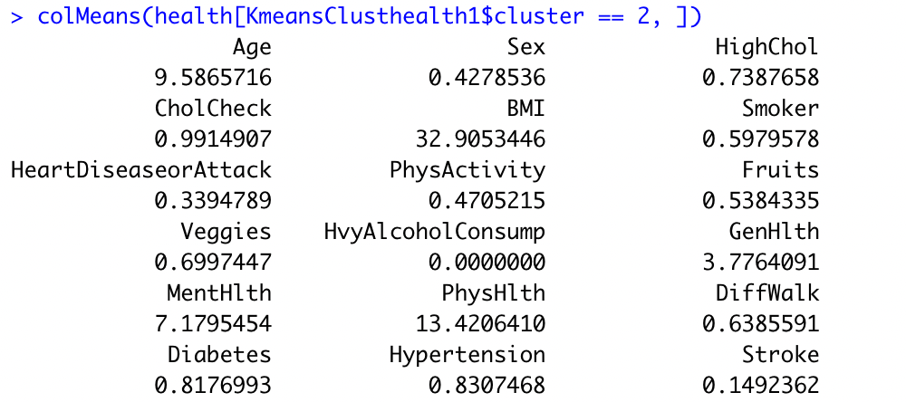



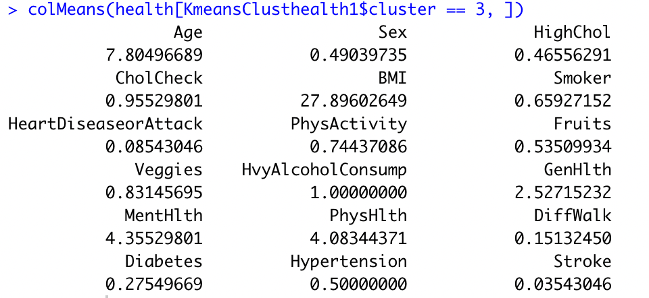

Forming the Clusters

Slide 20
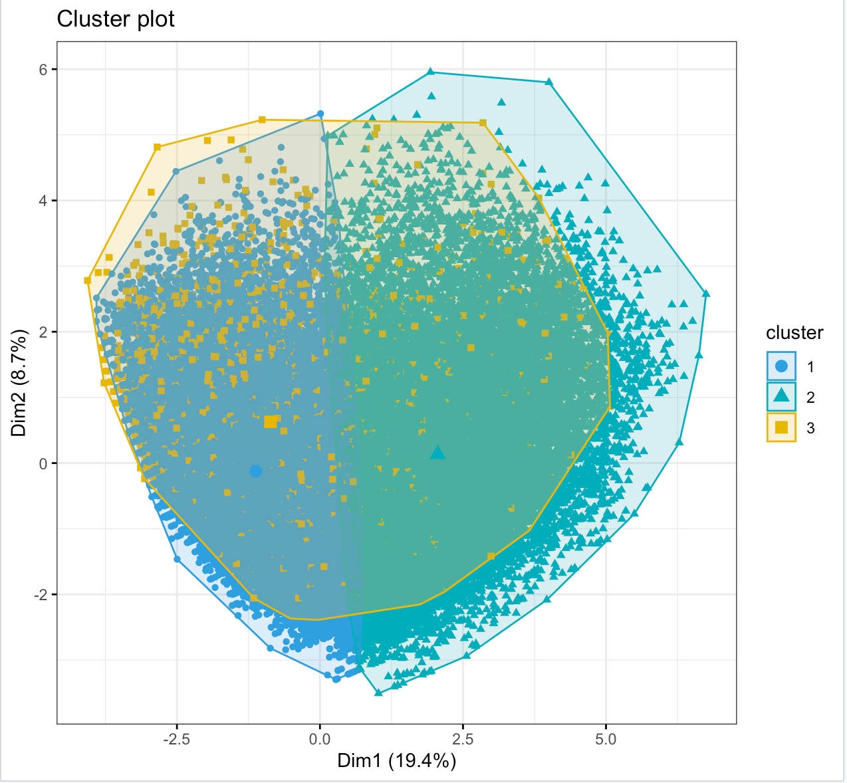
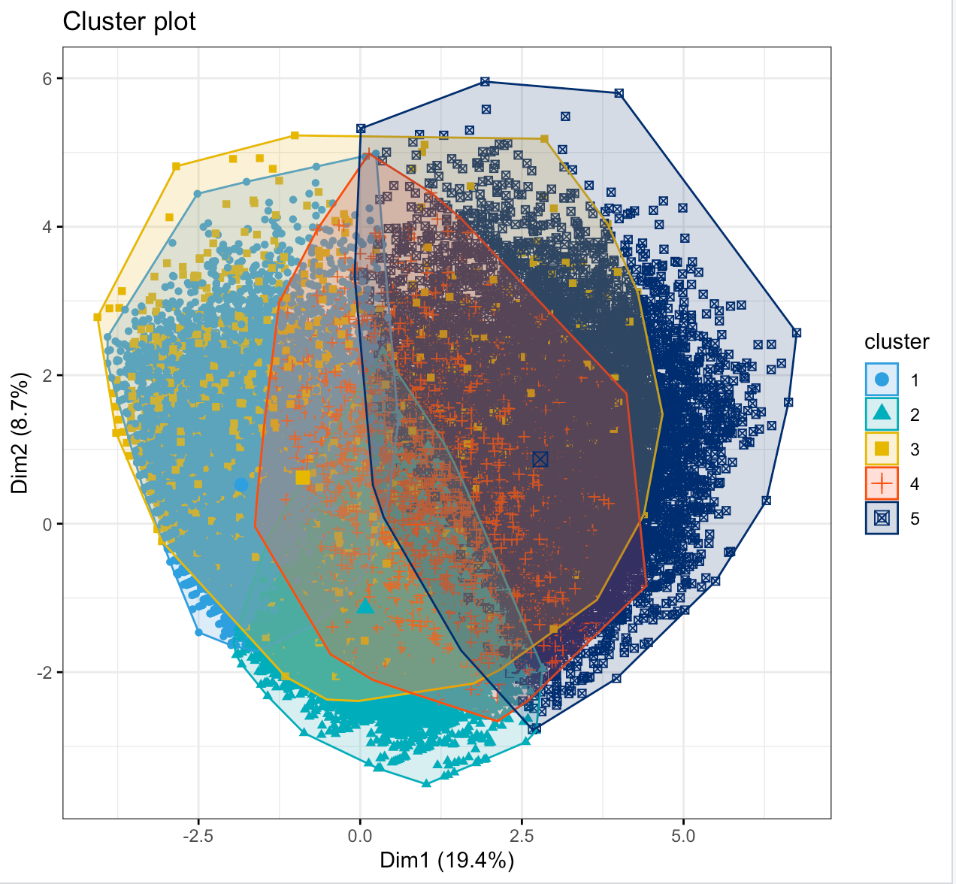
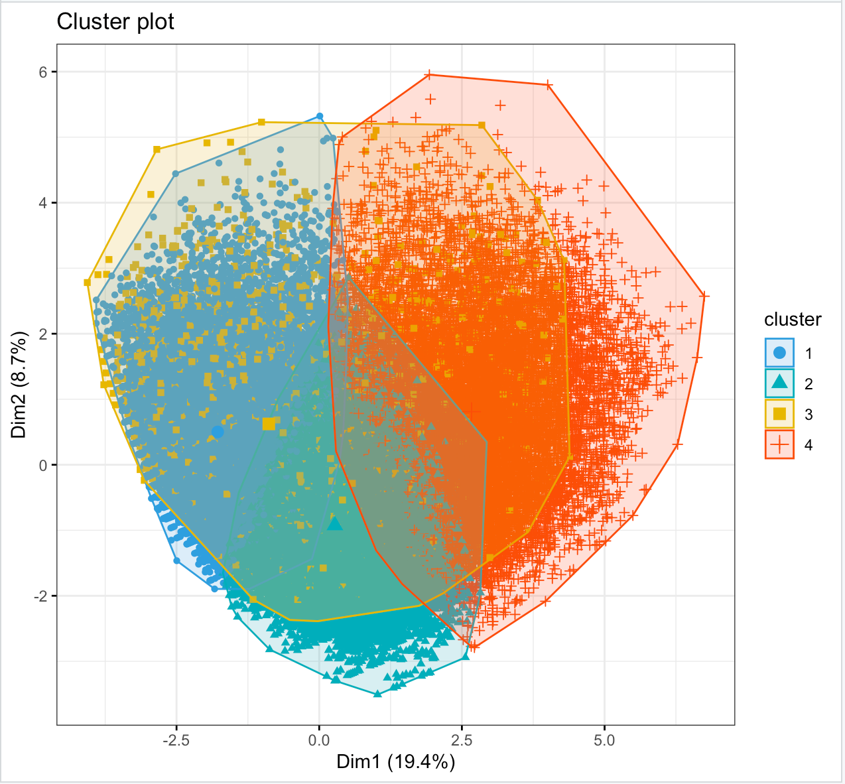
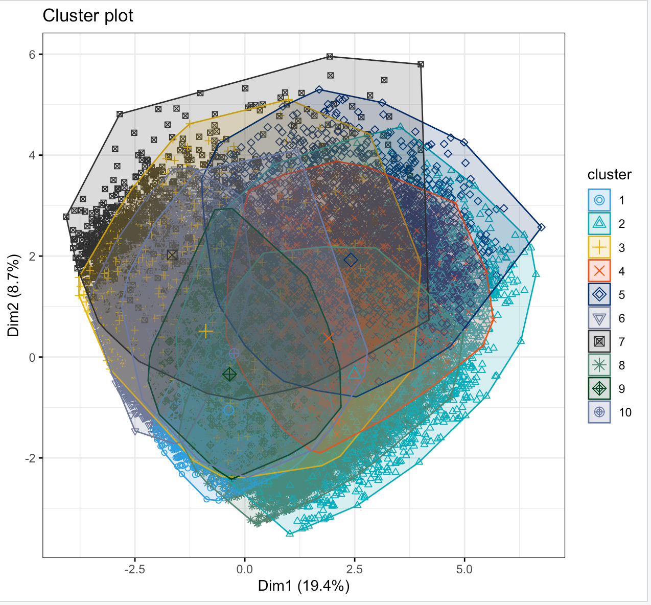
Understanding the Clusters

Slide 21
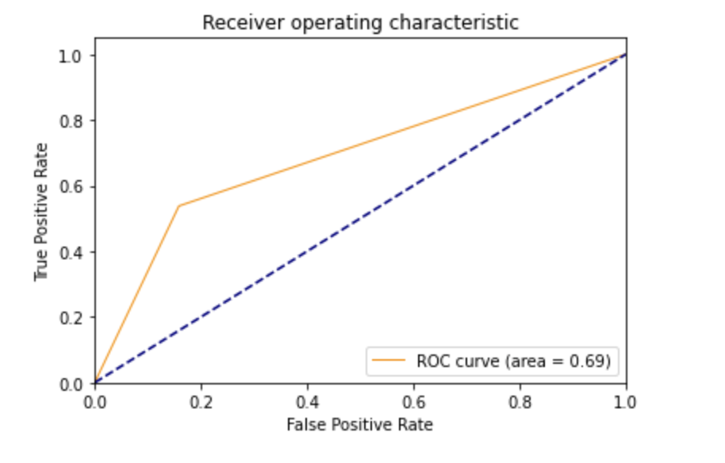
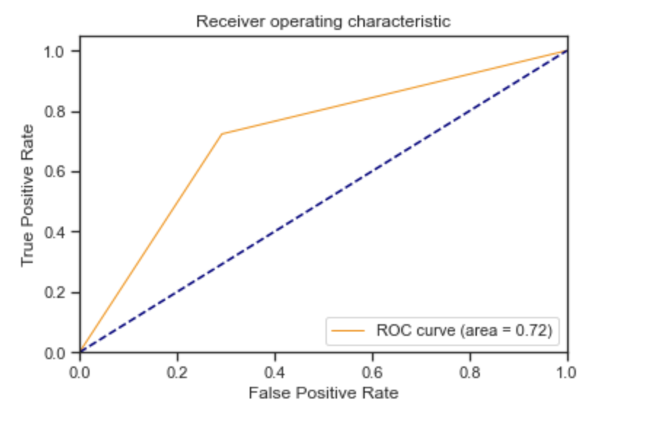
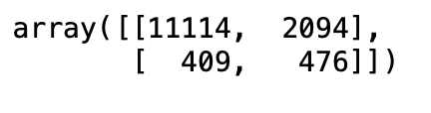
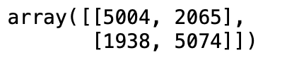
GNB Classification

Slide 22

Hierarchical
Clustering

Slide 23
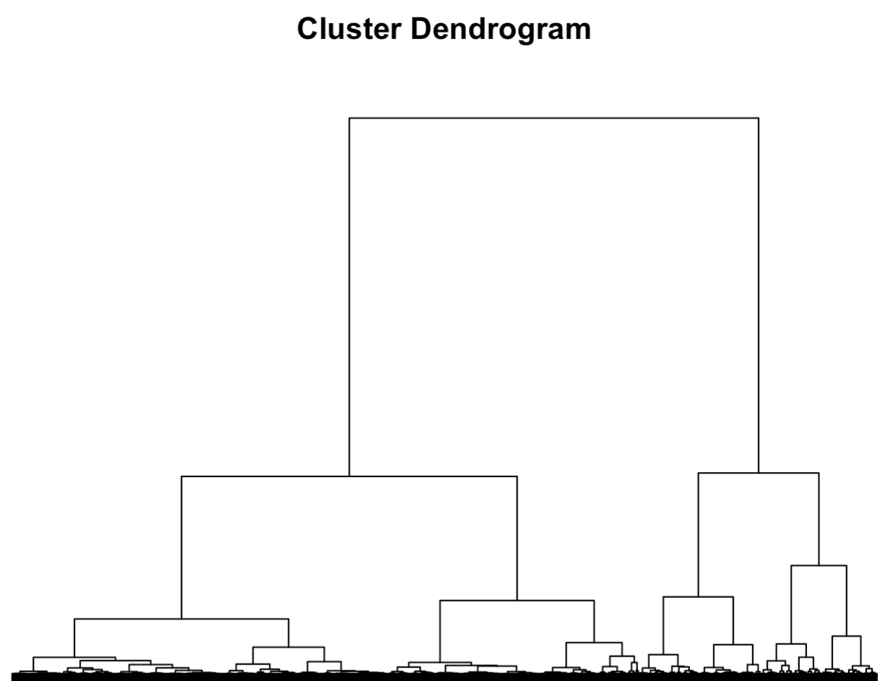
Forming the Clusters

Slide 24




Forming the Clusters

Slide 25
Cluster Groups
Cluster 1
Cluster 4
Healthiest group:
Low BMI, smoking, heart disease
High physical, general, and mental health
Almost none have D, H, or S
Youngest group:
Mostly females
Low fruits & veggies, mental & physical health
High smoking, heart disease
Fairly high D, H, and S
Cluster 2
Cluster 3
Average group:
High BMI
Average every other value
Fairly high D and H, not S
Oldest group:
Low alcohol consumption, general & physical health
High cholesterol, heart disease, difficulty walking
Very high D, H, and S

Slide 26

Conclusion

Slide 27



Future Project Improvements
Deep dive into one model, rather than spend time on several different models
Retrieve additional data:
Ethnicity information, to find a possible link to the health conditions
More data on people with strokes to make a decision tree
Find ways to link this data and analysis to a company, to drive further importance

Slide 28
Recommendations
Avoid
Pursue
Heavy alcohol consumption
Physical activity
Smoking
Eat healthy
High cholesterol
Mental health

Slide 29
Thank You

Slide 30
Appendix
Dataset: https://www.kaggle.com/datasets/prosperchuks/health-dataset
Originates from BRFSS 2015 (from the CDC)
“This is a clean dataset of over 70,692 survey responses to the CDC's BRFSS 2015. There are 18 feature variables and 3 target variables, Diabetes, Hypertension, and Stroke, each target variable having 2 classes. This dataset is balanced.”

Slide 31
Hierarchical Clustering
data = read.csv("health_data.csv")
str(data)
set.seed(88)
#install.packages("caTools")
library(caTools)
####################################################
datasplit = sample.split(data, SplitRatio = 0.3)
data2 = subset(data, datasplit == TRUE)
distances = dist(data2, method="euclidean")
clusterHealth = hclust(distances, method="ward.D") plot(clusterHealth)
####################################################
clusterGroups = cutree(clusterHealth, k=4)
tapply(data2$Age, clusterGroups, mean)
tapply(data2$Sex, clusterGroups, mean)
tapply(data2$HighChol, clusterGroups, mean)
tapply(data2$CholCheck, clusterGroups, mean)
tapply(data2$BMI, clusterGroups, mean)
tapply(data2$Smoker, clusterGroups, mean)
tapply(data2$HeartDiseaseorAttack, clusterGroups, mean)
tapply(data2$PhysActivity, clusterGroups, mean)
tapply(data2$Fruits, clusterGroups, mean)
tapply(data2$Veggies, clusterGroups, mean)
tapply(data2$HvyAlcoholConsump, clusterGroups, mean)
tapply(data2$GenHlth, clusterGroups, mean)
tapply(data2$MentHlth, clusterGroups, mean)
tapply(data2$PhysHlth, clusterGroups, mean)
tapply(data2$DiffWalk, clusterGroups, mean)
tapply(data2$Diabetes, clusterGroups, mean)
tapply(data2$Hypertension, clusterGroups, mean)
tapply(data2$Stroke, clusterGroups, mean)

Slide 32
Hierarchical Clustering
 | Cluster 1 | Cluster 2 | Cluster 3 | Cluster 4
Age | 8.2 | 9 | 9.46 | 7.96
Sex | .46 | .5 | .42 | .37
HighCol | .42 | .58 | .63 | .61
CholCheck | .96 | .98 | .99 | .96
BMI | 25.38 | 35.62 | 31.3 | 30.3
Smoker | .41 | .46 | .54 | .57
HeartDiseaseorAttack | .08 | .14 | .27 | .21
PhysActivity | .82 | .68 | .54 | .57
Fruits | .65 | .58 | .6 | .53
Veggies | .82 | .76 | .75 | .74
HvyAlcoholConsump | .05 | .03 | .02 | .05
GenHlth | 2.29 | 2.83 | 3.74 | 3.59
MentHlth | .54 | 1.22 | 1.36 | 22.24
PhysHlth | .68 | 1.34 | 22.26 | 14.41
DiffWalk | .08 | .24 | .58 | .48
Diabetes | .32 | .64 | .68 | .57
Hypertension | .4 | .68 | .72 | .63
Stroke | .03 | .04 | .1 | .11

Slide 33
Random Forest
#Diabetes
set.seed(888)
split = sample.split(Data$Diabetes, SplitRatio = 0.75)
DiabetesTrain = subset(Data, split==TRUE)
DiabetesTest = subset(Data, split==FALSE)
DiabetesTrain$Diabetes = as.factor(DiabetesTrain$Diabetes)
DiabetesTest$Diabetes = as.factor(DiabetesTest$Diabetes)
DiabetesForest = randomForest(Diabetes ~ Age + Sex + HighChol + CholCheck + BMI + Smoker + HeartDiseaseorAttack + PhysActivity + Fruits + Veggies + HvyAlcoholConsump + GenHlth + MentHlth + PhysHlth + DiffWalk + Hypertension + Stroke, data = DiabetesTrain)
DiabetesPredictForest = predict(DiabetesForest, newdata=DiabetesTest)
tbl = table(DiabetesTest$Diabetes, DiabetesPredictForest)
sum(diag(tbl))/sum(tbl)
Accuracy results: 0.7494907

Slide 34
Random Forest (cont.)
#Hypertension
set.seed(888)
split = sample.split(Data$Hypertension, SplitRatio = 0.75)
HypertensionTrain = subset(Data, split==TRUE)
HypertensionTest = subset(Data, split==FALSE)
HypertensionTrain$Hypertension = as.factor(HypertensionTrain$Hypertension)
HypertensionTest$Hypertension = as.factor(HypertensionTest$Hypertension)
HypertensionForest = randomForest(Hypertension ~ Age + Sex + HighChol + CholCheck + BMI + Smoker + HeartDiseaseorAttack + PhysActivity + Fruits + Veggies + HvyAlcoholConsump + GenHlth + MentHlth + PhysHlth + DiffWalk + Diabetes + Stroke, data = HypertensionTrain)
HypertensionPredictForest = predict(HypertensionForest, newdata=HypertensionTest)
tbl = table(HypertensionTest$Hypertension, HypertensionPredictForest)
sum(diag(tbl))/sum(tbl)
Accuracy results: 0.7326996

Slide 35
Random Forest (cont.)
#Stroke
set.seed(888)
split = sample.split(Data$Stroke, SplitRatio = 0.75)
StrokeTrain = subset(Data, split==TRUE)
StrokeTest = subset(Data, split==FALSE)
StrokeTrain$Stroke = as.factor(StrokeTrain$Stroke)
StrokeTest$Stroke = as.factor(StrokeTest$Stroke)
StrokeForest = randomForest(Stroke ~ Age + Sex + HighChol + CholCheck + BMI + Smoker + HeartDiseaseorAttack + PhysActivity + Fruits + Veggies + HvyAlcoholConsump + GenHlth + MentHlth + PhysHlth + DiffWalk + Diabetes + Hypertension, data = StrokeTrain)
StrokePredictForest = predict(StrokeForest, newdata=StrokeTest)
tbl = table(StrokeTest$Stroke, StrokePredictForest)
sum(diag(tbl))/sum(tbl)
Accuracy results: 0.9373055

Slide 36
Logit Regression
data = read.csv("health_data.csv")
str(data)
set.seed(88)
#install.packages("caTools")
library(caTools)
#####################################################
#Diabetes Prediction
#####################################################
#splitting data into train and test according to diabetes data
split = sample.split(data$Diabetes, SplitRatio = 0.75)
DiabetesTrain = subset(data, split==TRUE)
DiabetesTest = subset(data, split==FALSE)
#building the Logit model
DiabetesModel = glm(Diabetes ~ Age + Sex + PhysActivity + Fruits + HighChol + BMI + HeartDiseaseorAttack + Veggies + HvyAlcoholConsump + GenHlth + DiffWalk + Hypertension, data = DiabetesTrain, family = binomial)
summary(DiabetesModel)
#Evaluating the model
DiabetesTest$PredictedRisk = predict(DiabetesModel, type="response", newdata = DiabetesTest)
tbl = table(DiabetesTest$Diabetes, DiabetesTest$PredictedRisk > 0.45)
accuracy_model = sum(diag(tbl))/sum(tbl) #74.25%
#BaseLine Accuracy
BaseLineAccuracy = sum(data$Diabetes)/nrow(data) #50%

Slide 37
#####################################################
#Hypertension Prediction
#####################################################
#splitting data into train and test according to diabetes data
split = sample.split(data$Hypertension, SplitRatio = 0.75)
HypertensionTrain = subset(data, split==TRUE)
HypertensionTest = subset(data, split==FALSE)
#building the Logit model
HypertensionModel = glm(Hypertension ~ Age + Sex + PhysActivity + Fruits + HighChol + BMI + HeartDiseaseorAttack + Veggies + GenHlth + PhysHlth + DiffWalk + Diabetes, data = HypertensionTrain, family = binomial)
summary(HypertensionModel)
#Evaluating the model
HypertensionTest$PredictedRisk = predict(HypertensionModel, type="response", newdata = HypertensionTest)
tbl1 = table(HypertensionTest$Hypertension, HypertensionTest$PredictedRisk > 0.47)
accuracy_model1 = sum(diag(tbl1))/sum(tbl1) #74.32%
#BaseLine Accuracy
BaseLineAccuracy1 = sum(data$Hypertension)/nrow(data) #56.34%
#####################################################
#Stroke Prediction
#####################################################
#splitting data into train and test according to diabetes data
split = sample.split(data$Stroke, SplitRatio = 0.75)
StrokeTrain = subset(data, split==TRUE)
StrokeTest = subset(data, split==FALSE)
#building the Logit model
StrokeModel = glm(Stroke ~ Age + Sex + PhysActivity + Fruits + HighChol + BMI + HeartDiseaseorAttack + Veggies + GenHlth + DiffWalk + Hypertension + Diabetes, data = StrokeTrain, family = binomial)
summary(StrokeModel)
#Evaluating the model
StrokeTest$PredictedRisk = predict(StrokeModel, type="response", newdata = StrokeTest)
tbl2 = table(StrokeTest$Stroke, StrokeTest$PredictedRisk > 0.5)
accuracy_model2 = sum(diag(tbl2))/sum(tbl2) #93.78
#BaseLine Accuracy
BaseLineAccuracy2 = 1-sum(StrokeTrain$Stroke)/nrow(StrokeTrain) #93.78%

Slide 38
Kmeans
# Health Data
health = read.csv("/Users/health_data.csv")
str(health)
summary(health)
library(caret)
prepoch = preProcess(health) # pre-processes the data
healthNorm = predict(prepoch, health)
summary(healthNorm)
apply(healthNorm,2,sd)
# K-means clustering for 3 clusters
set.seed(88)
KmeansClusthealth1 = kmeans(healthNorm, centers = 3, iter.max = 1000)
KmeansClusthealth1
KmeansClusthealth1$centers
table(KmeansClusthealth1$cluster)
## Compare the average values in each of the variables for the 3 clusters with unnormalized data
colMeans(health[KmeansClusthealth1$cluster == 1, ])
colMeans(health[KmeansClusthealth1$cluster == 2, ])
colMeans(health[KmeansClusthealth1$cluster == 3, ])

Slide 39
Kmeans (cont.)
# K-means clustering for 5 clusters
set.seed(88)
KmeansClusthealth2 = kmeans(healthNorm, centers = 5, iter.max = 1000)
KmeansClusthealth2
KmeansClusthealth2$centers
table(KmeansClusthealth2$cluster)
## Compare the average values in each of the variables for the 3 clusters with unnormalized data
colMeans(health[KmeansClusthealth2$cluster == 1, ])
colMeans(health[KmeansClusthealth2$cluster == 2, ])
colMeans(health[KmeansClusthealth2$cluster == 3, ])
colMeans(health[KmeansClusthealth2$cluster == 4, ])
colMeans(health[KmeansClusthealth2$cluster == 5, ])
# K-means clustering for 10 clusters
set.seed(88)
KmeansClusthealth3 = kmeans(healthNorm, centers = 10, iter.max = 1000)
KmeansClusthealth3
KmeansClusthealth3$centers
## Compare the average values in each of the variables for the 3 clusters with unnormalized data
colMeans(health[KmeansClusthealth3$cluster == 1, ])
colMeans(health[KmeansClusthealth3$cluster == 2, ])
colMeans(health[KmeansClusthealth3$cluster == 3, ])
colMeans(health[KmeansClusthealth3$cluster == 4, ])
colMeans(health[KmeansClusthealth3$cluster == 5, ])
colMeans(health[KmeansClusthealth3$cluster == 6, ])
colMeans(health[KmeansClusthealth3$cluster == 7, ])
colMeans(health[KmeansClusthealth3$cluster == 8, ])
colMeans(health[KmeansClusthealth3$cluster == 9, ])
colMeans(health[KmeansClusthealth3$cluster == 10, ])

Slide 40
Classification Trees
############################################################################
#CART MODEL
############################################################################
library("caTools")
library(rpart)
library("rpart.plot")
#checking correlation
cor(data) #no high correlation
#####################################################
#Diabetes Prediction CART Model
#####################################################
DiabCart = rpart(Diabetes ~ ., method="class", data=DiabetesTrain, minbucket=3000)
prp(DiabCart)
DiabCartPredict = predict(DiabCart, newdata=DiabetesTest, type="class")
tbl = table(DiabetesTest$Diabetes, DiabCartPredict)
sum(diag(tbl))/sum(tbl) #70.73%
#Baseline Model
1-sum(DiabetesTest$Diabetes)/nrow(DiabetesTest)
#####################################################
#Hypertension Prediction CART Model
#####################################################
HypertensionCart = rpart(Hypertension ~ ., method="class", data=HypertensionTrain, minbucket=5000)
prp(HypertensionCart)
HypertensionCartPredict = predict(HypertensionCart, newdata=HypertensionTest, type="class")
tbl = table(HypertensionTest$Hypertension, HypertensionCartPredict)
sum(diag(tbl))/sum(tbl) #71.97%
#Baseline Model
BaseLineAccuracy1 = sum(data$Hypertension)/nrow(data) #56.34%

Slide 41
Classification Trees (cont.)
#####################################################
#Stroke Prediction CART Model
#####################################################
StrokeCart = rpart(Stroke ~ ., method="class", data=StrokeTrain)
prp(StrokeCart)
StrokeCartPredict = predict(StrokeCart, newdata=StrokeTest, type="class")
tbl = table(StrokeTest$Stroke, StrokeCartPredict)
sum(diag(tbl))/sum(tbl)
#Baseline Model
BaseLineAccuracy2 = sum(data$Stroke)/nrow(data) #62.17%

